Slide 1





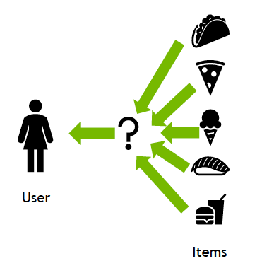
AI-Based Health & Food Recommender with Visual Feedback
Presented By,
Yashaswini B U

Slide 2





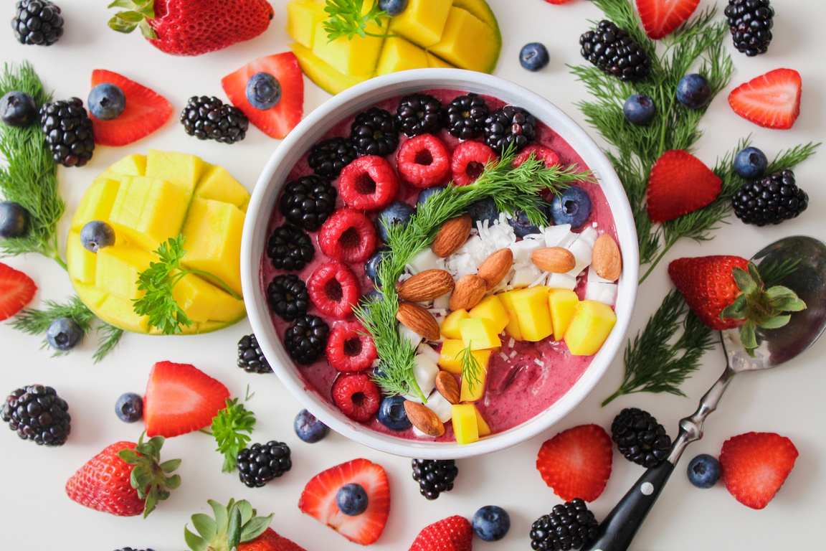

Introduction to AI Health Recommender
Uses Python Turtle Graphics for a visual interface.
AI logic based on Sleep, Water Intake, and Exercise.
Promotes healthy habits in an engaging, visual way.
01

Slide 3


Objective
Evaluate health habits: sleep, water, and exercise.
Recommend suitable food based on input
Provide motivational visual feedback.
02

Slide 4
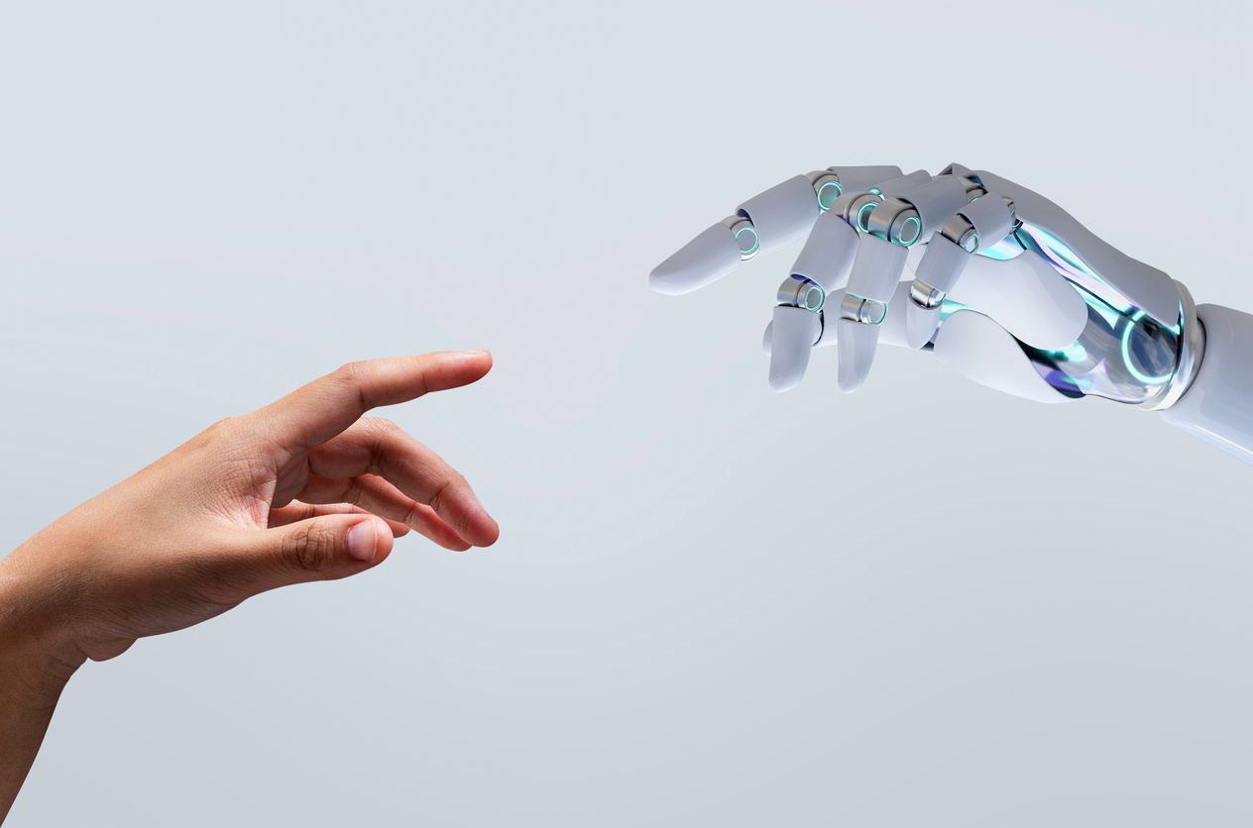

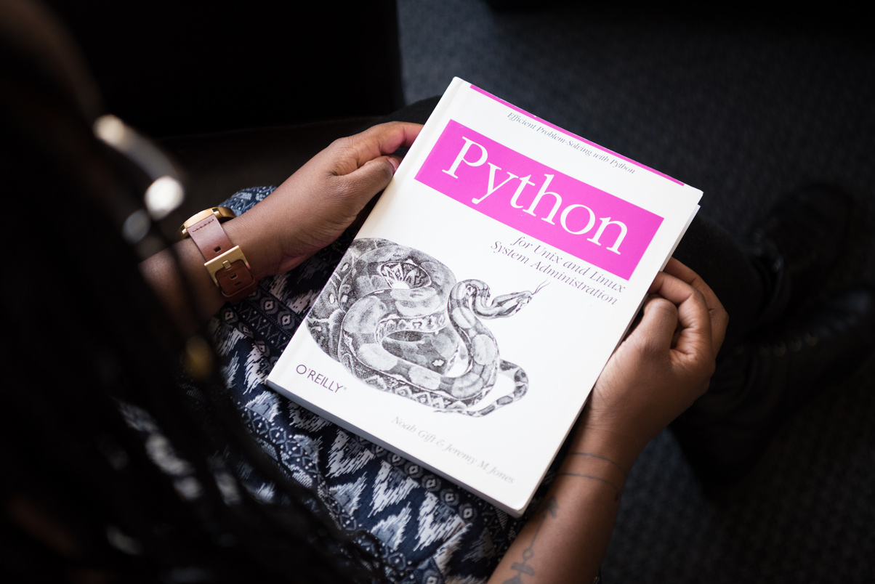

Technologies Used
Python
Turtle Graphics
Rule-Based AI Logic
03

Slide 5

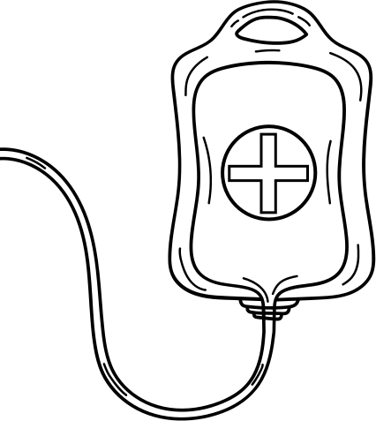

How It Works
Users input daily health habits.
AI logic evaluates health condition.
Turtle graphics display result with colors & messages
04

Slide 6
Health Logic
CATEGORY | CONDITIONS | COLOR
Healthy | Sleep ≥ 7, Water ≥ 8, Exercise = Yes | Green
Needs Improvement | Sleep ≥ 5, Water ≥ 5 Exercise = No | Orange
Unhealthy | Sleep < 5, Water < 5 Exercise = No | Red
05

Slide 7


User Interaction Flow
Step 1: Enter health-related inputs.
Step 2: AI logic analyzes and classifies health status.
Step 3: Visual output is shown using turtle window.
Step 4: Food recommendation is displayed.
06

Slide 8
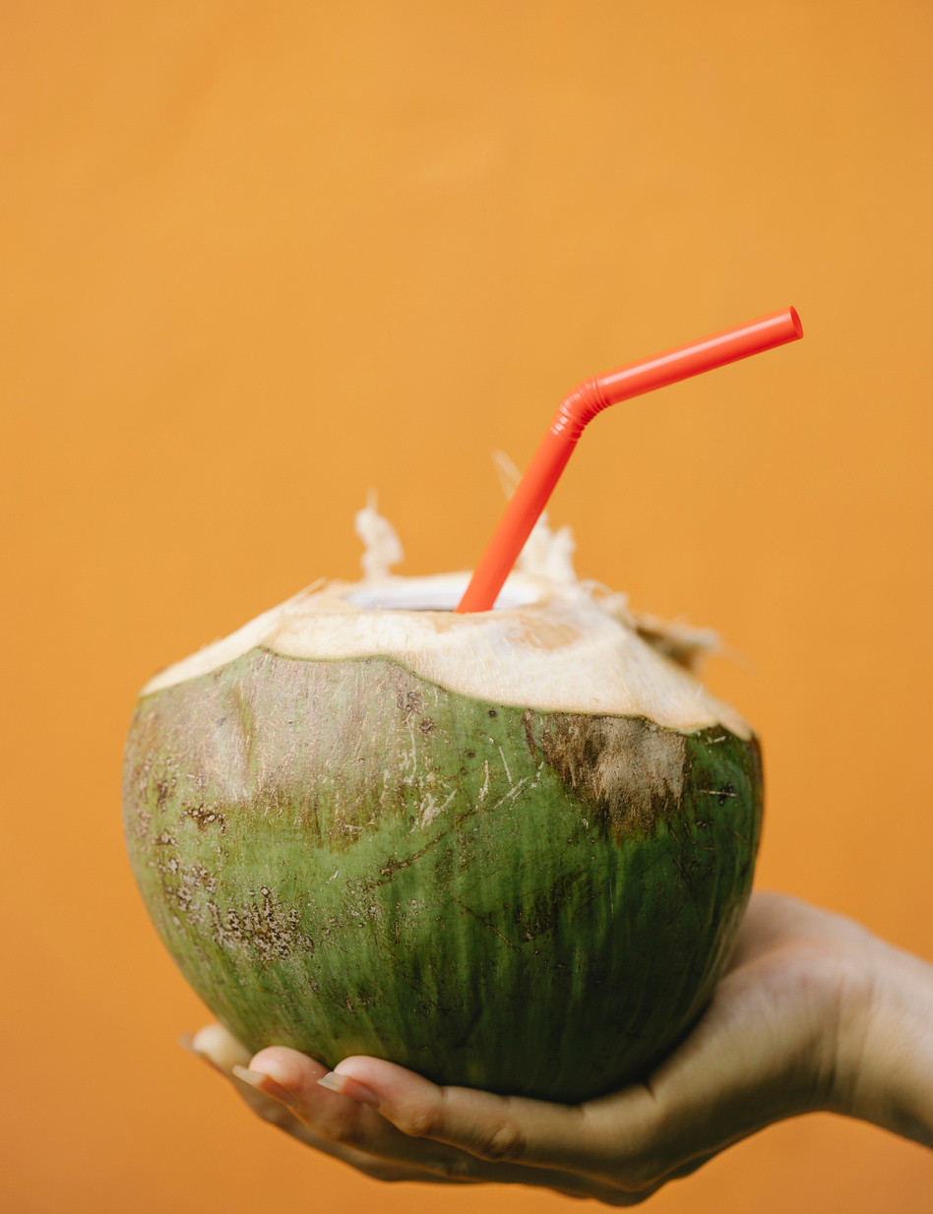
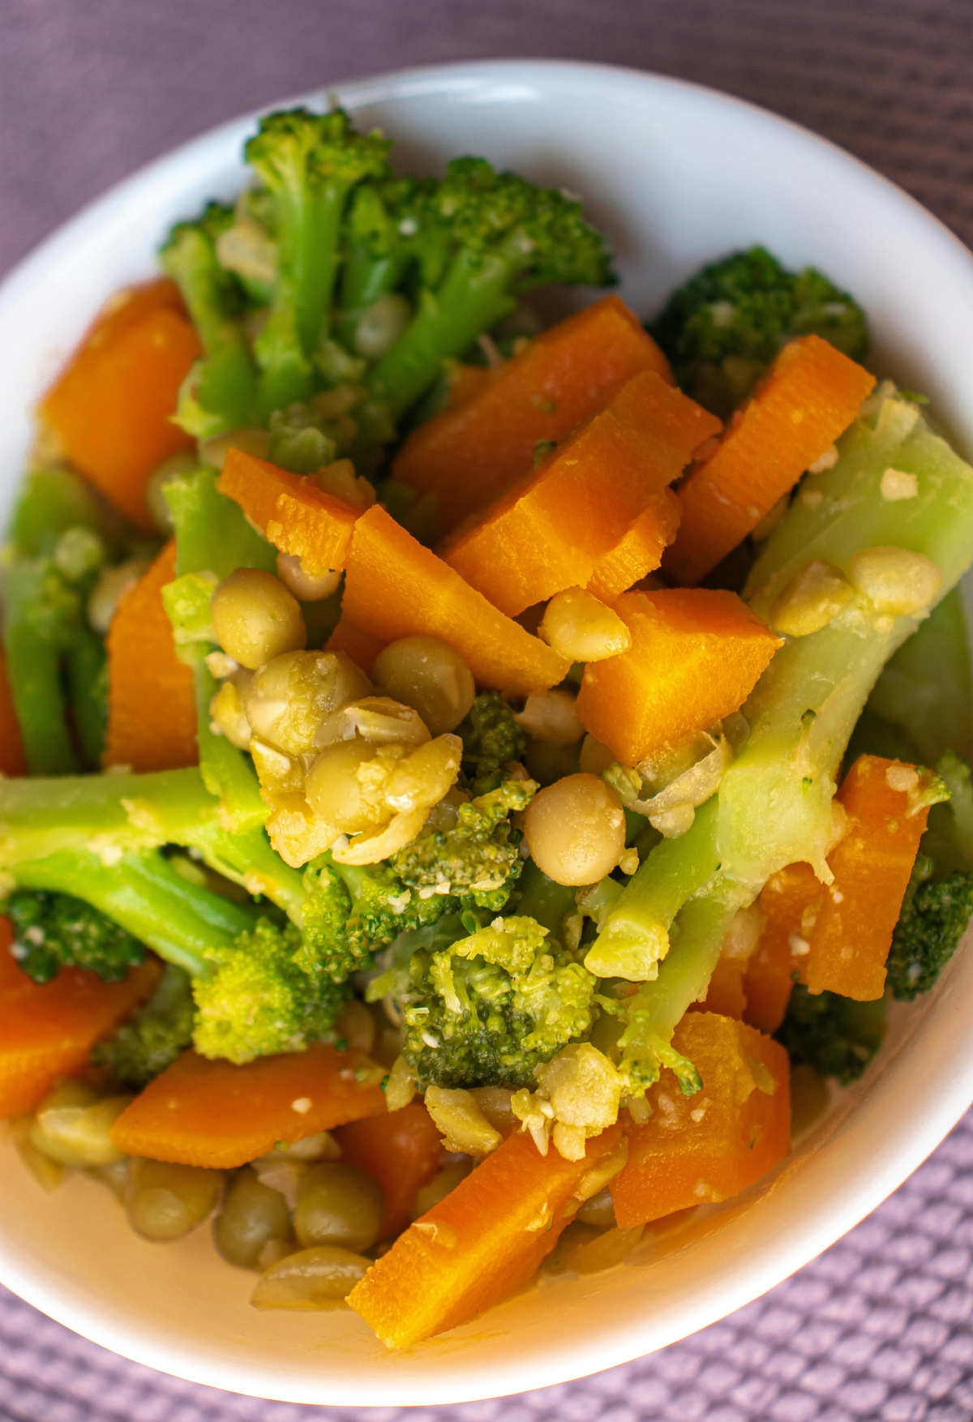
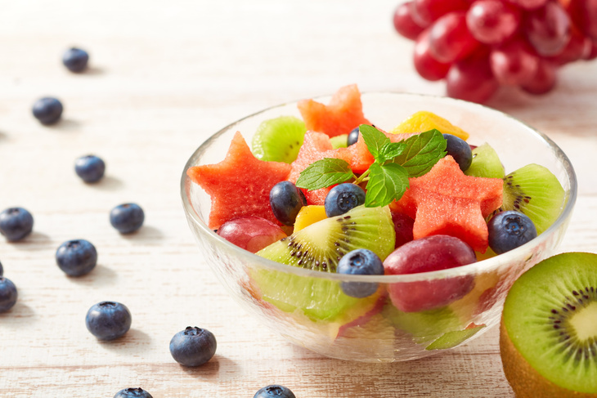

Healthy: Fruit Salad, Nuts, Cucumber Slices
Needs Improvement: Coconut Water, Banana,Paneer
Unhealthy: 🍠 Sweet Potato, Oats, Steamed Vegetables
Food Recommendations
07

Slide 9
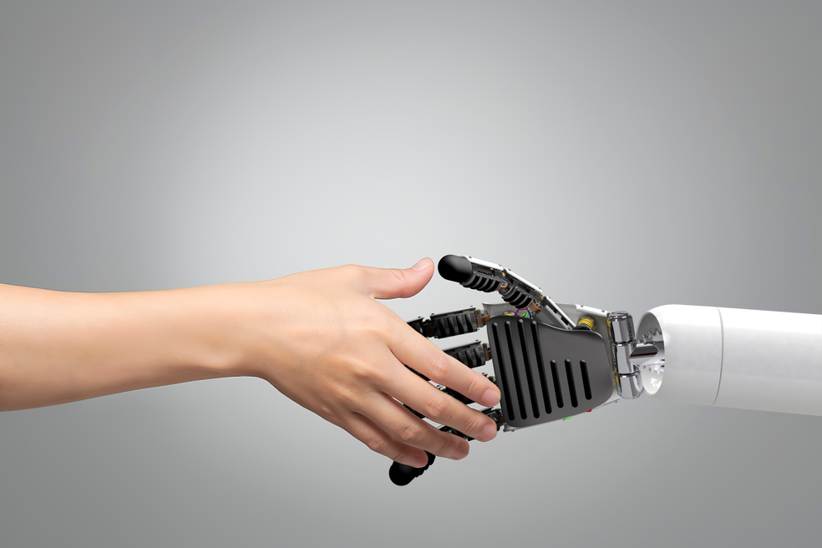
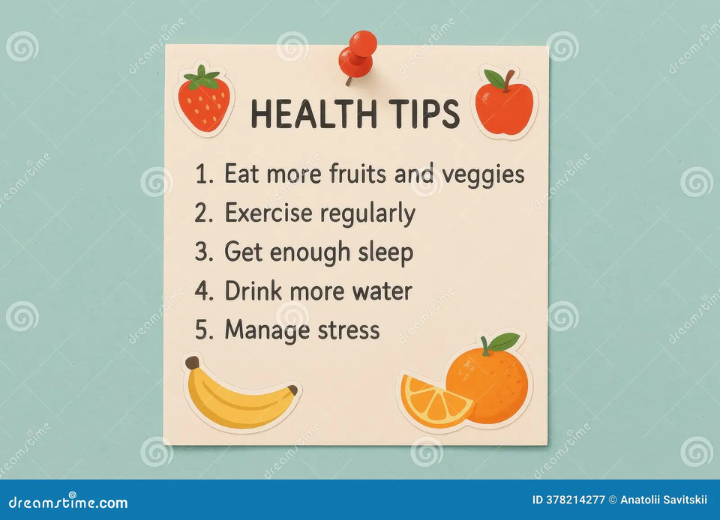

Key Features
Interactive & Visual
Simple and Engaging
Health Tips & Food Suggestions
08

Slide 10

Thank You
Stay Healthy & Take Care!
😊

